Slide 1
Credit Card System
Team 1- Ayush Jain, Harsh Yadav ,Avinash Kumar
Team name – Hello World

Slide 2
Abstract
Credit card system is a desktop application that deals with the approval of credit card. It is reasonable for administration of credit card. It includes the details of the user that he can check whether he is applicable for applying the credit card, he can check the credit score and If he is applicable then he can apply for the credit card and can select which type of card he wants.

Slide 3
Scope
Perform CRUD operation on customers database
Present analysis on data of customers
Program modules for customer, bank admin to apply for credit card, approve requests and calculate credit score based on the data stored

Slide 4
Modules
We have used two modules in this system.
1- Customer
2- Bank Admin

Slide 5
Customer details
User can login through id and password.
User can see all the account details.
User can check whether he is applicable for applying credit card or not.
User can apply for the card be selecting which type of card he wants with what monthly limit.

Slide 6
Bank Admin
Admin can see all the details of the customer.
Admin can see all the pending request.
Admin can approve for the credit card by validating customer’s information.
Admin can see and analyse different reports

Slide 7
Technology Stack
Front end: Tkinter (Python)
Back end: Python, MySQL, PHPMyAdmin
Reporting tool: Pandas and matplotlib
Version Control: Git and GitHub
Editor: VS Code

Slide 8
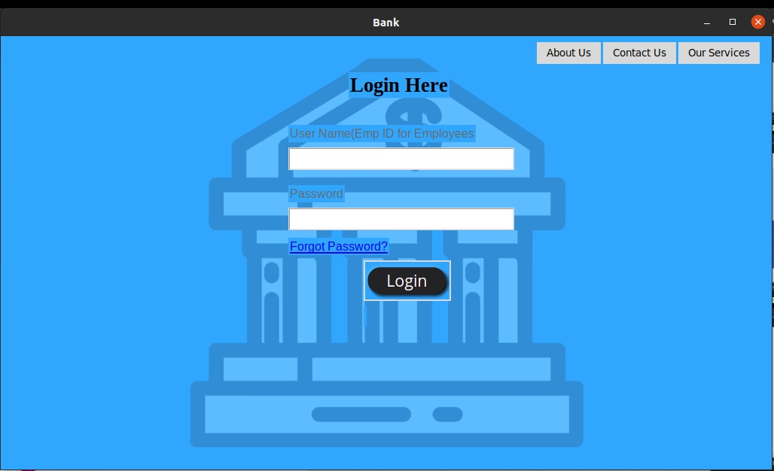
Login page

Slide 9
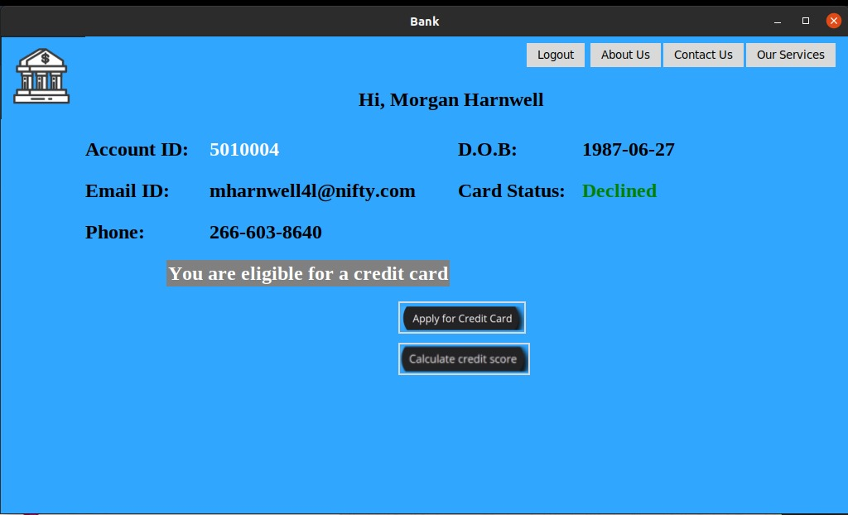
Main page

Slide 10
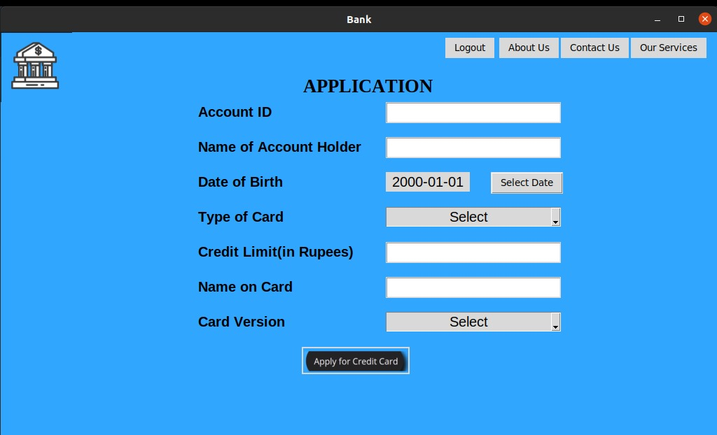
Apply for credit card

Slide 11
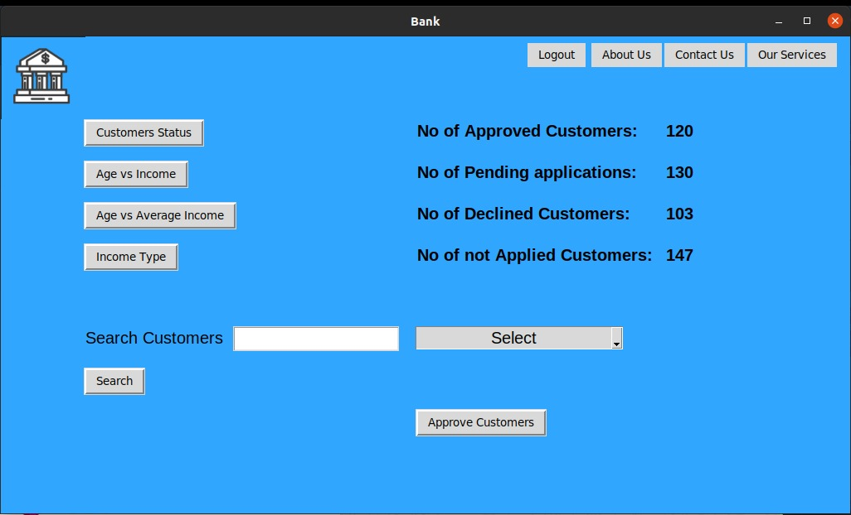
Admin page

Slide 12
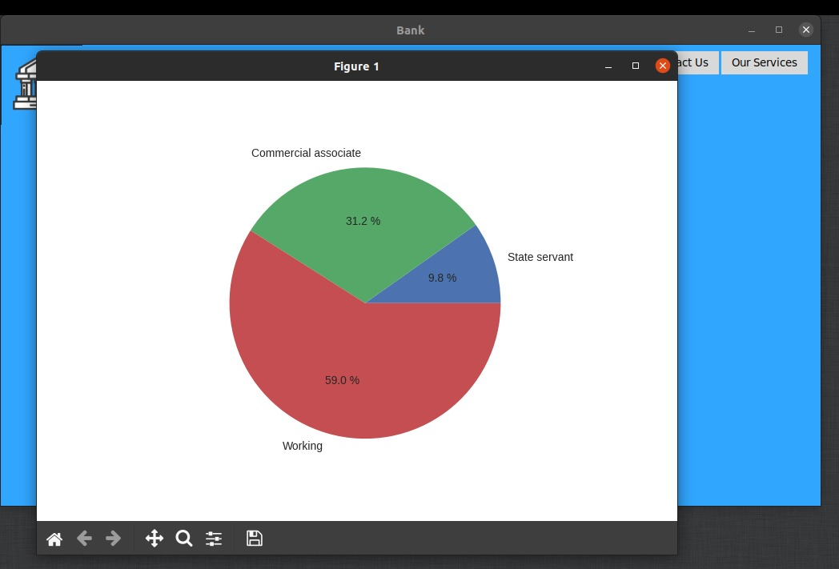
Reporting analysis

Slide 13
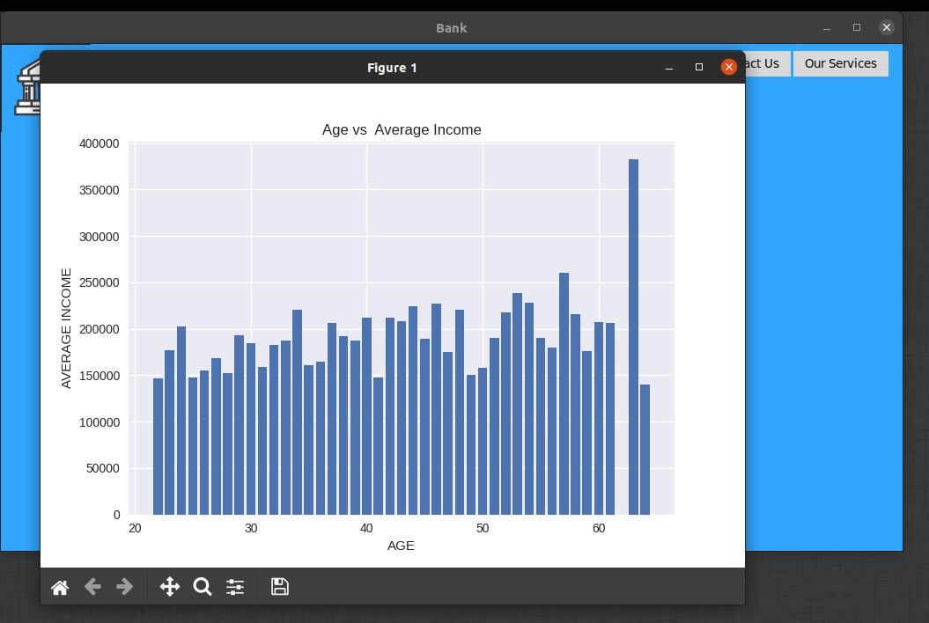

Slide 14
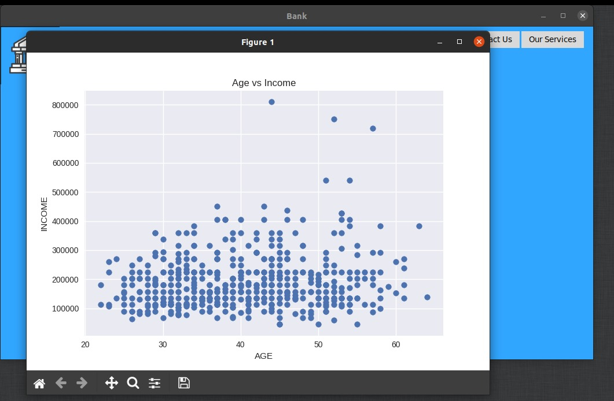

Slide 15
